Slide 1
AUTOMATED ETL WITH DATALAKE STORAGE
Utilize Azure Data Factory to orchestrate an ETL pipeline that ingests data from various sources into Azure Data Lake Storage.Use Azure Databricks for complex data transformations.

Slide 2
Project Overview
The goal of the project, based on the outlined steps, is to create a robust ETL (Extract, Transform, Load) pipeline using Azure services.
The primary objective is to seamlessly ingest data from diverse sources into Azure Data Lake Storage (ADLS) and perform complex data transformations using Azure Databricks. This end-to-end solution aims to automate and streamline the data processing workflow, ensuring efficient, reliable, and scalable data integration.
Azure Databricks will be utilized for advanced data processing and analytics on the stored data within the Data Lake.

Slide 3
PREREQUISITES
Azure Subscription:
Appropriate rights for Azure Data Factory, Data Lake Storage and Databricks.
Data Sources

Slide 4
Azure Data Factory
Azure Data Factory is Azure's cloud ETL service for scale-out serverless data integration and data transformation. It offers a code-free UI for intuitive authoring and single-pane-of-glass monitoring and management.

Slide 5
AZURE DATA LAKE STORAGE
Azure Data Lake Storage is a cloud-based, enterprise data lake solution. It's engineered to store massive amounts of data in any format, and to facilitate big data analytical workloads. You use it to capture data of any type and ingestion speed in a single location for easy access and analysis using various frameworks.

Slide 6
AZURE DATABRICKS
Azure Databricks is a unified, open analytics platform for building, deploying, sharing, and maintaining enterprise-grade data, analytics, and AI solutions at scale.

Slide 7
OVERVIEW OF DATA MOVEMENT AND ORGANIZATION capabilities in Azure Data Factory
Efficient Data Movement:
Azure Data Factory provides efficient data movement across various sources and destinations, enabling seamless data transfer and organization.
Robust Data Organization:
It offers robust data organization capabilities, allowing you to structure and catalog data for easy access and analysis.

Slide 8
CONFIGURE AND SET UP AZURE DATA FACTORY TO MOVE AND ORGANIZE DATA IN AZURE DATA LAKE STORAGE
Connectivity Options:
Azure Data Factory supports a wide range of connectivity options to access and integrate data from disparate sources.
Data Flow Orchestration:
It facilitates the orchestration of data flows, allowing you to define and manage complex data processing and movement tasks.

Slide 9
INTRODUCTION TO AZURE DATABRICKS AND ITS CAPABILITIES FOR DATA PROCESSING AND TRANSFORMATION
Data Processing Power
Azure Databricks provides powerful data processing capabilities, including advanced analytics and machine learning.
Integration with Azure Services
It seamlessly integrates with various Azure services, enabling comprehensive data processing and analytics workflows.

Slide 10
LEVERAGING AZURE DATABRICKS NOTEBOOKS FOR DATA TRANSFORMATION
Exploring the use of Azure Databricks notebooks for data transformation tasks, including cleaning, aggregating, and enriching data.

Slide 11
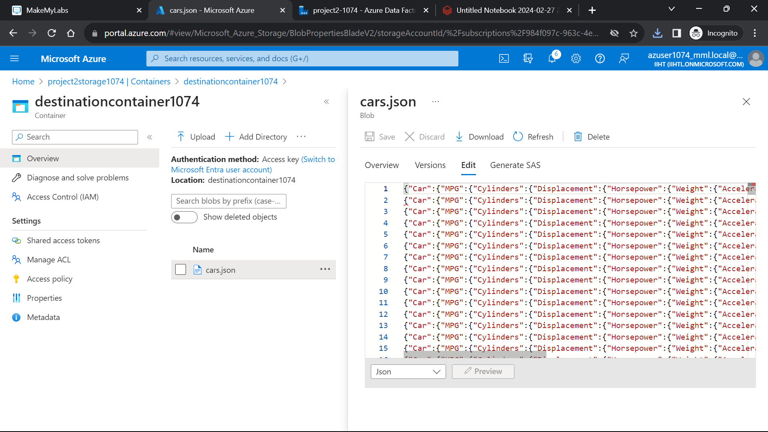
OUTPUTS

Slide 12
THANKYOU

